Slide 1
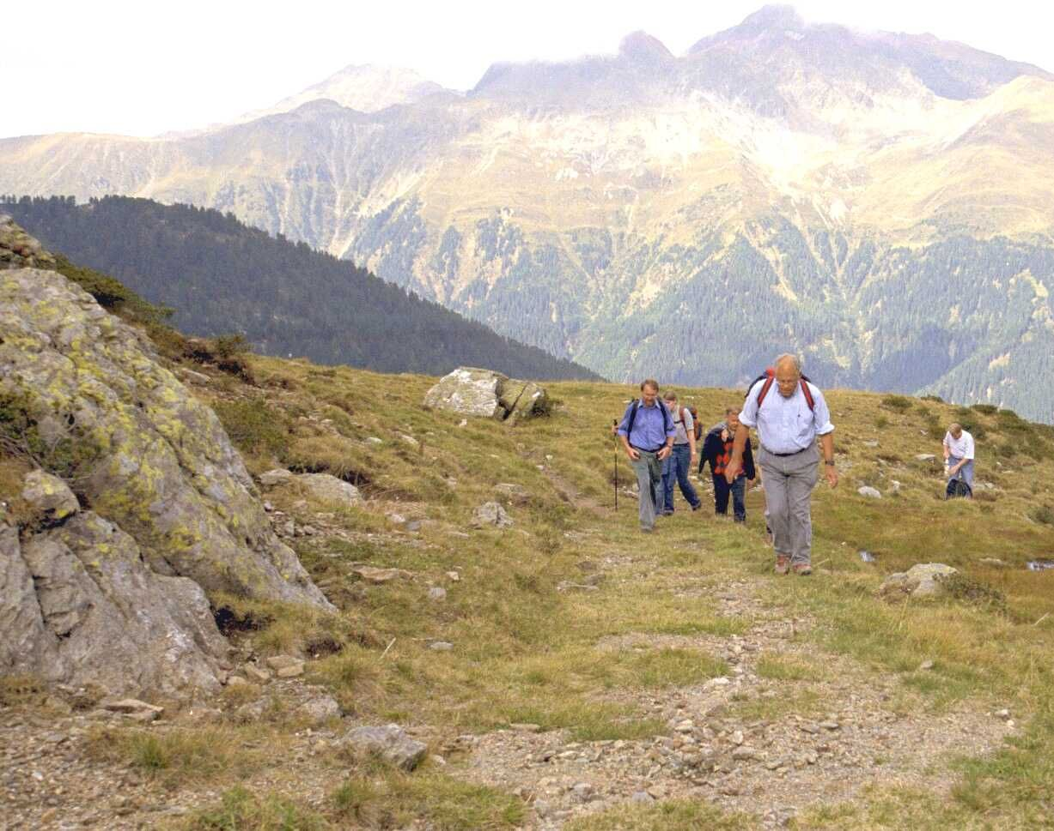
In Memoriam Professor Dr.-Ing Joachim Hagenauer
Memories from early 90s until today
Dr. Thomas Stockhammer

Slide 2
“Joh 1,16: Von seiner Fülle haben wir alle genommen – Gnade um Gnade.”
“From his fullness we have all received, grace upon grace.”
Notes:
These words from the Gospel of John capture something essential about Professor Joachim Hagenauer. They speak of a life that gave generously, quietly, and with remarkable trust in others. And he believed in God!

Slide 3
In 1996
Professor Hagenauer was one of the pioneers of channel coding and mobile communications, at a time when these fields were still young, bold, and full of promise.
But those of us who worked with him know that his true legacy reaches far beyond publications, patents, or programs.
It lies in how he treated people – especially us young researchers.

Slide 4
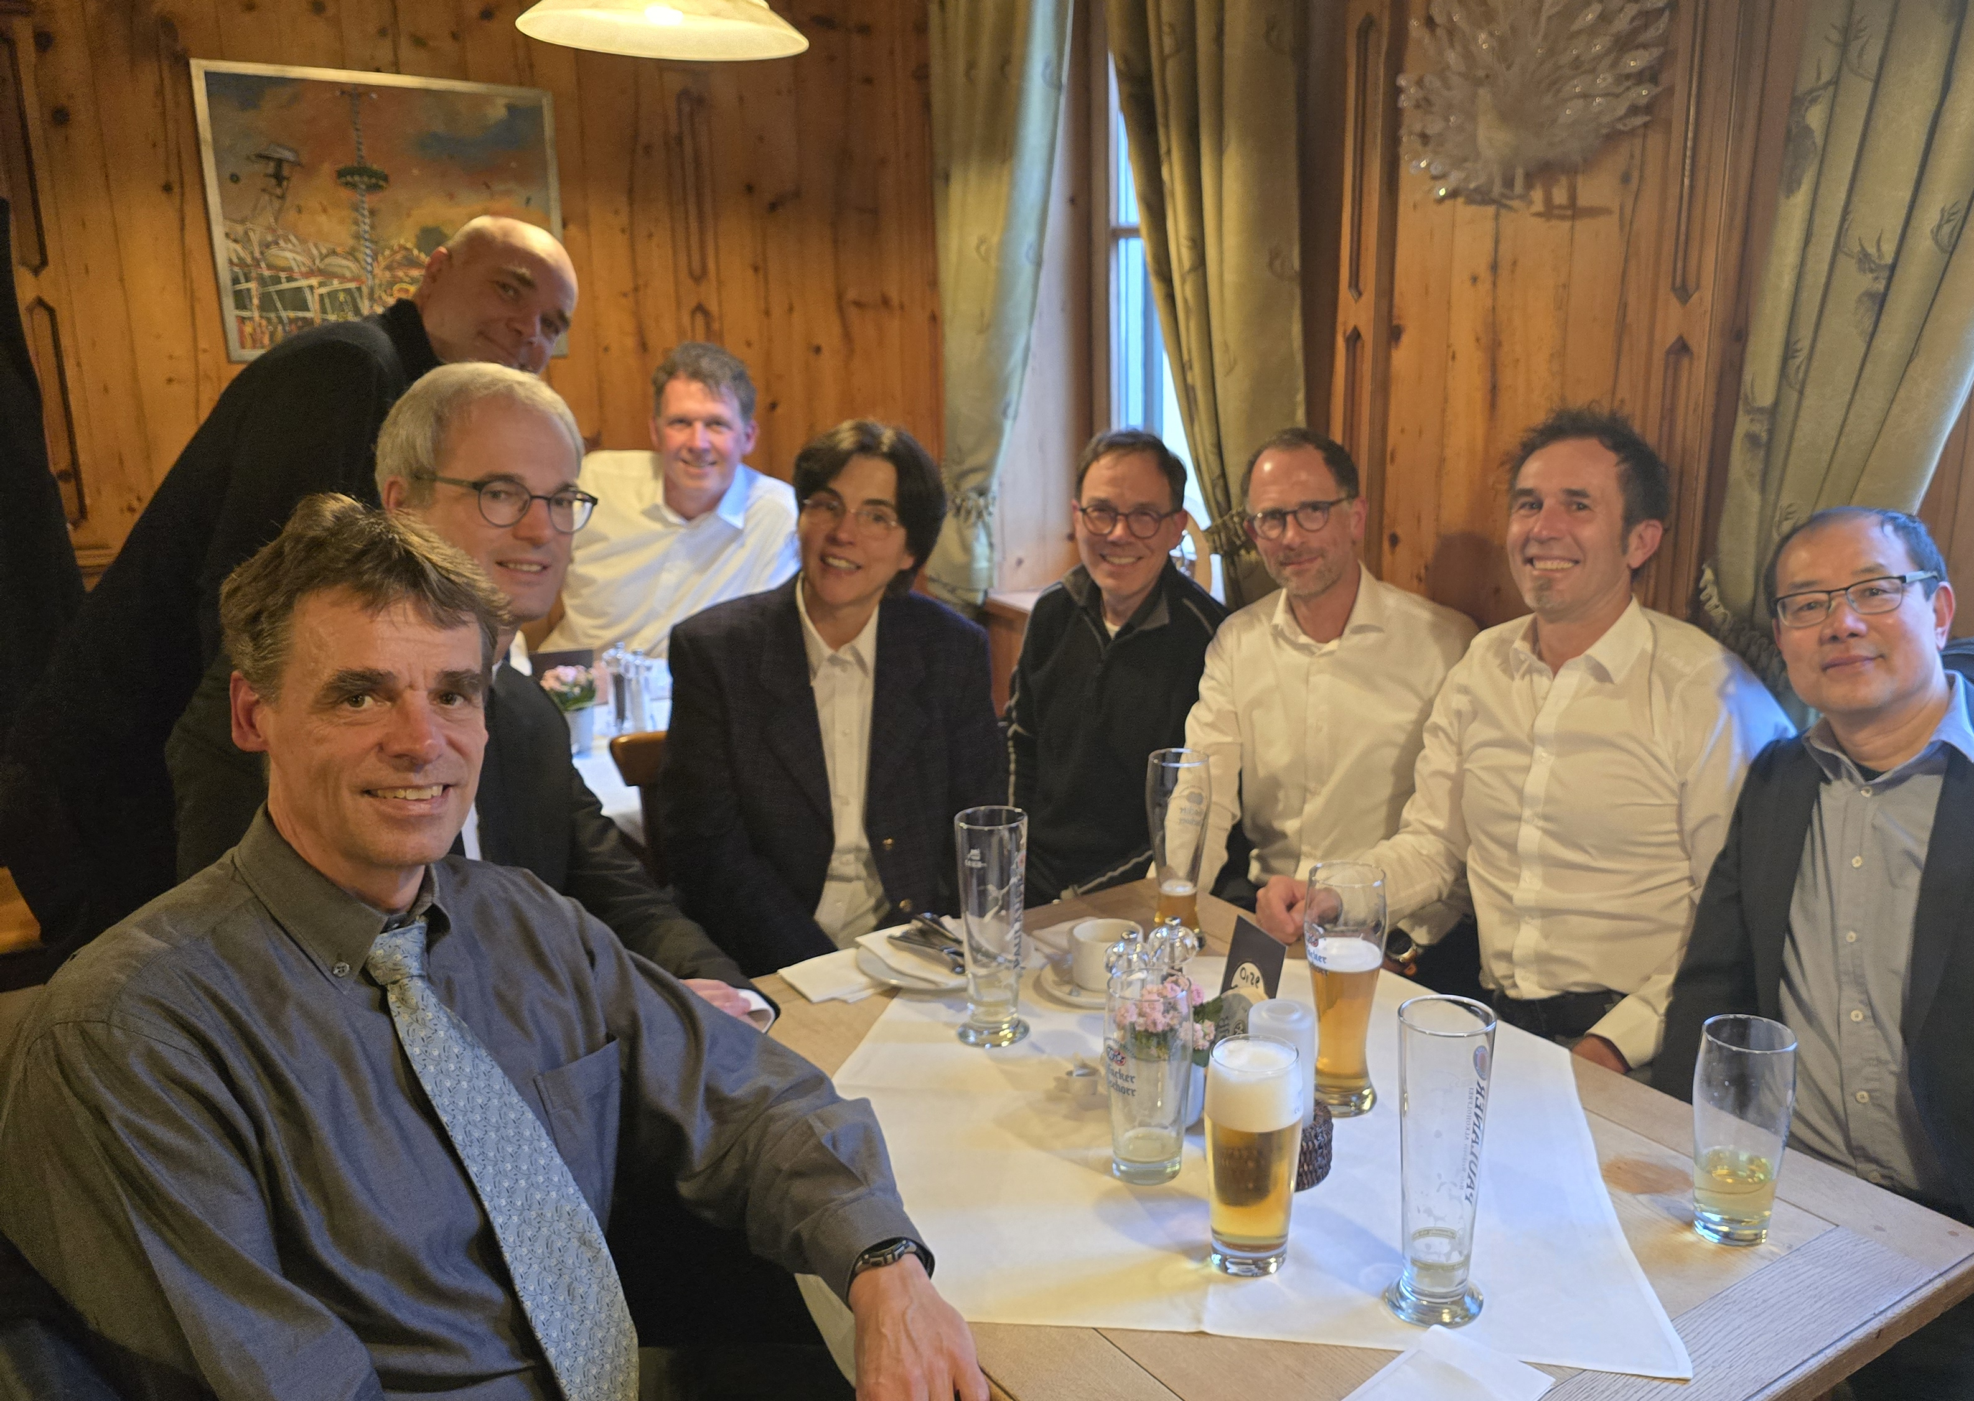
February 4, 2026
At the memorial service, his grandchildren Samuel and Junia spoke about their grandfather in words that immediately felt familiar to all of us.
They described a man who was hospitable, cultivated, curious, always willing to listen—someone who combined intellect with warmth, humour, and ease.
In hearing them, we realised that the professor we admired was the same person they called “Opa”.

Slide 5
“Why don’t you try this?”
Many of us experienced his confidence before we felt fully ready ourselves. He had a rare ability to say, almost casually:
“Why don’t you try this?” – and suddenly an opportunity existed. For some, that meant being encouraged to write a diploma thesis abroad.
For others, a research stay far from home. In my own case, it meant being able to do a diploma thesis in the United States in 1996, and later starting a research stay at UC San Diego in 2000.
At the time, these were not obvious or easy paths – but for him, opening such doors felt natural.

Slide 6
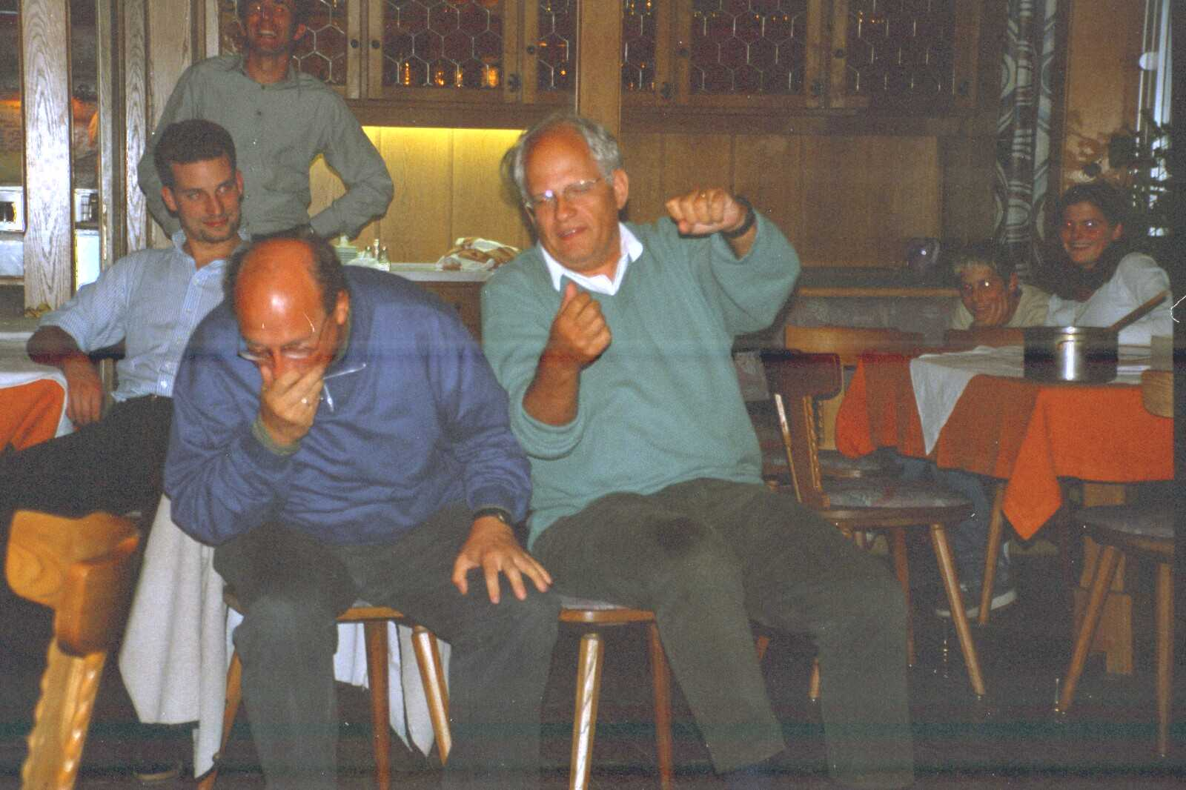
Humour
That unity of life and character was perhaps his greatest strength. He inspired not through authority, but through example.
He encouraged exploration, remained open to new ideas throughout his life, and approached both science and people with optimism and trust in the good.
And he believed in god and was full of humour …

Slide 7

The Creation of the First Book of Mobile Communications
Summary of a story from LNT Christmas party 1999

Slide 8
Day 1
In the beginning, God created the office and the computer.
Now the assistants were without knowledge and without zeal, and darkness was upon room N3404; yet the spirit of God moved through the corridors.
And God said, Let there be a book. And there should have been a book. And God saw the book, that it was good. And God separated the book from the paper. And God called the book Mobile Communications, and the paper he called Analog Decoder. And there was evening, and there was morning—the first day.

Slide 9
Day 2
And God said, Let there be a division among the students, and let there be a separation between students and students. And God made the Master programme and separated the students within Europe from those who were outside Europe. And it was so. And God called them Master students. And there was evening, and there was morning—the second day. (And still there was no book.)

Slide 10
Day 3
And God said, Let the hardware be gathered together on the second floor into one place, and let the mobile communications laboratory appear. And it was so. And God called the laboratory our flagship, and the gathering of computers he named after composers. And God saw that it was good. And God said, Let the computers bring forth results, systems that iterate, green and red spheres by which money may be extracted from unbelievers. And it was so. And there was evening, and there was morning—the third day. (And still there was no book.)

Slide 11
Day 4
And God said, Let examples be placed at the beginning of every chapter of the book, to distinguish good books from bad books, and to serve understanding for students and Siemens employees. Yet it did not come to pass. For God made two great patents: the greater to rule over fibre optics and magneto-optical disks, and the lesser to rule over multimedia data. And God set them into deeds as analog chips and sequential decoders, to rule over the digital world and probabilities with L-values and the Boxplus. And there was evening, and there was morning—the fourth day. (And still there was no book.)

Slide 12
Day 5
And God said, Let the first semesters swarm with living bachelors, and let masters fly above the diploma engineers beneath our white-and-blue sky. And God created the great reform of studies and midterm examinations by which the semesters abound. And God blessed them and said, Be fruitful and multiply; fill the offices of my chair with theoreticians, and let the others multiply at Siemens. And there was evening, and there was morning—the fifth day. (And still there was no book.)

Slide 13
Day 6
And God said, Let the university bring forth graduates of every kind: masters, creeping programming bachelors, and diploma engineers of the old order. And God made the projects of the DFG after space-time fashion, the projects with Siemens after AMR fashion, and all BMBF projects after whatever fashion. And God saw that it was good. And there was evening, and there was morning—the sixth day. (And still there was no book.)

Slide 14
Day 7
Thus the book and mobile communications and all the examples were never completed. Yet on the seventh day the assistant-angels finished the work which God had intended.
And God blessed the assistants and granted them vacation during the semester and whenever they desired. And on the seventh day he rested from all his work, and for the first time he read his book.
This is the story of the origin of the first book on mobile communications—and how it was in truth never written.

Slide 15
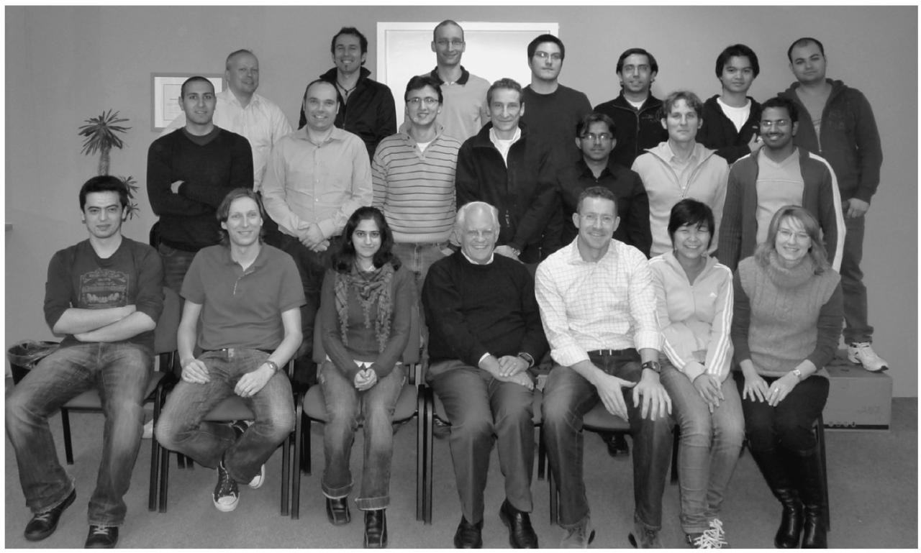
Nomor Research in 2004

Slide 16
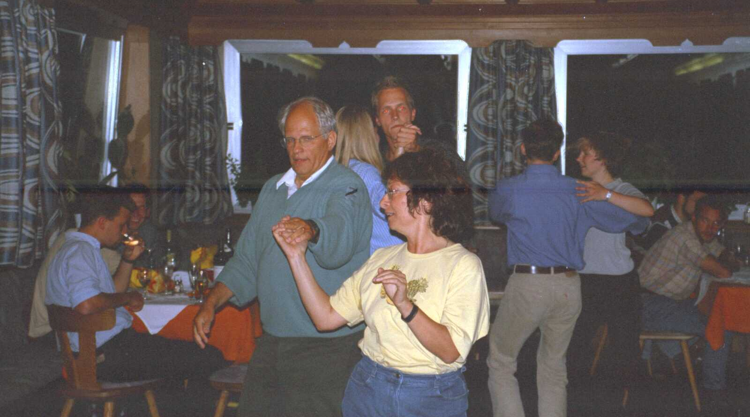
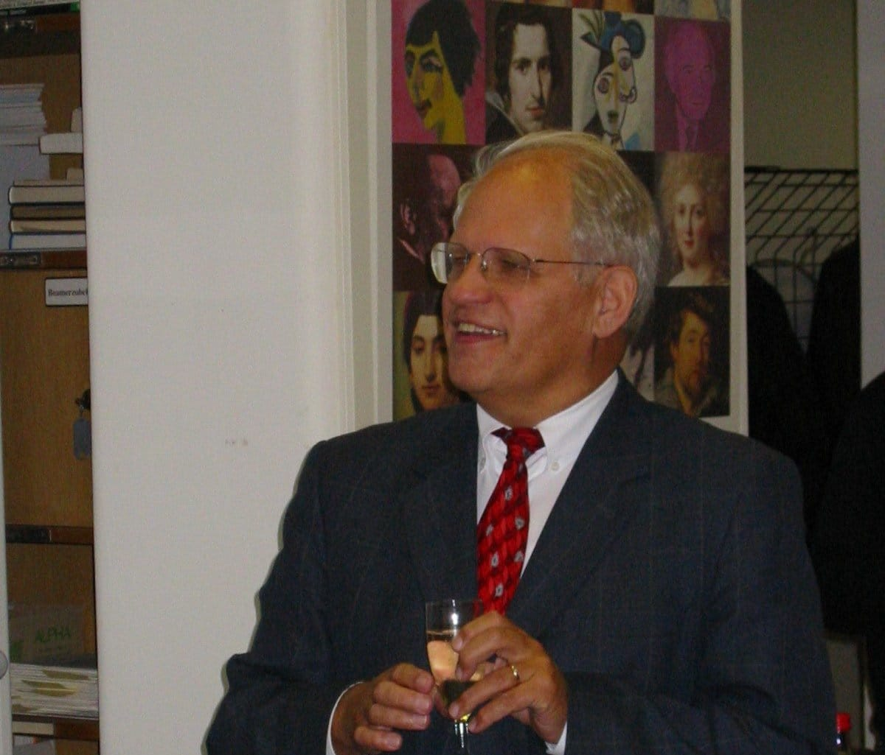
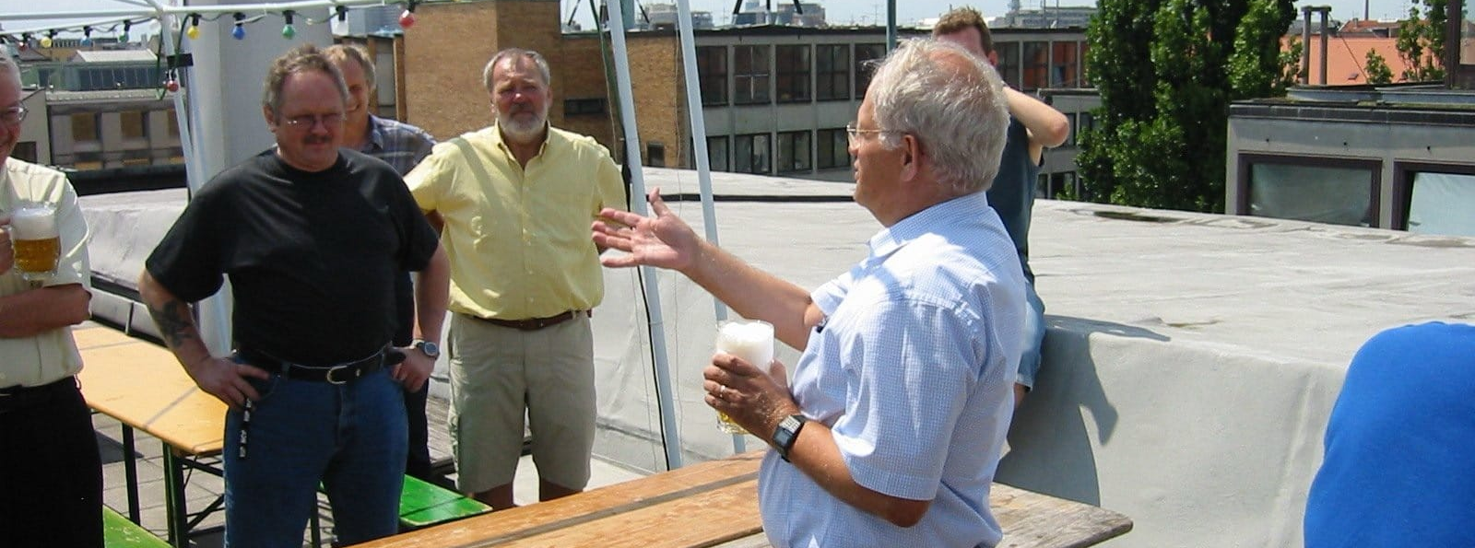
welcoming, socially engaged, educated, someone who listened attentively, enjoyed company, and always carried a quiet sense of humour and lightness.

Slide 17
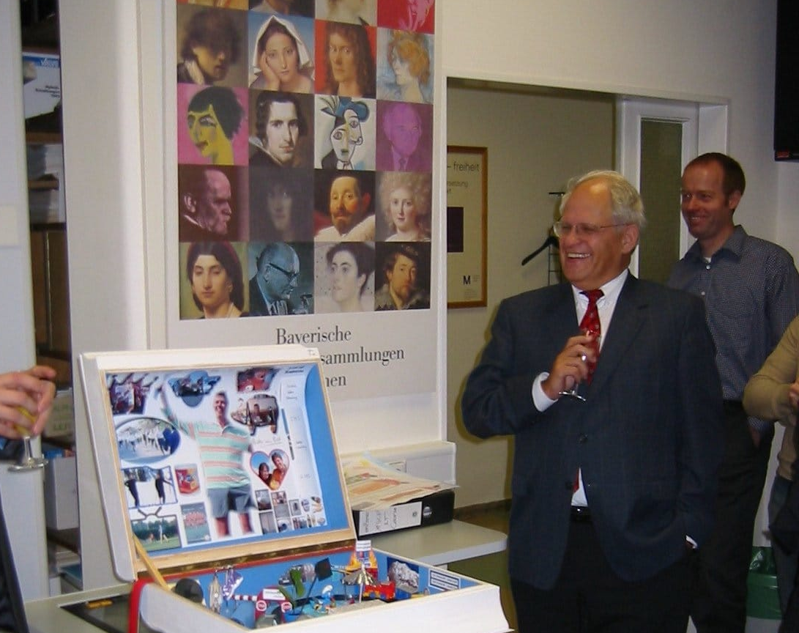
Thank you Professor Hagenauer “Joh 1,16: Von seiner Fülle haben wir alle genommen – Gnade um Gnade.”
“From his fullness we have all received, grace upon grace.”
Notes:
These words from the Gospel of John capture something essential about Professor Joachim Hagenauer. They speak of a life that gave generously, quietly, and with remarkable trust in others. And he believed in God!

Slide 18
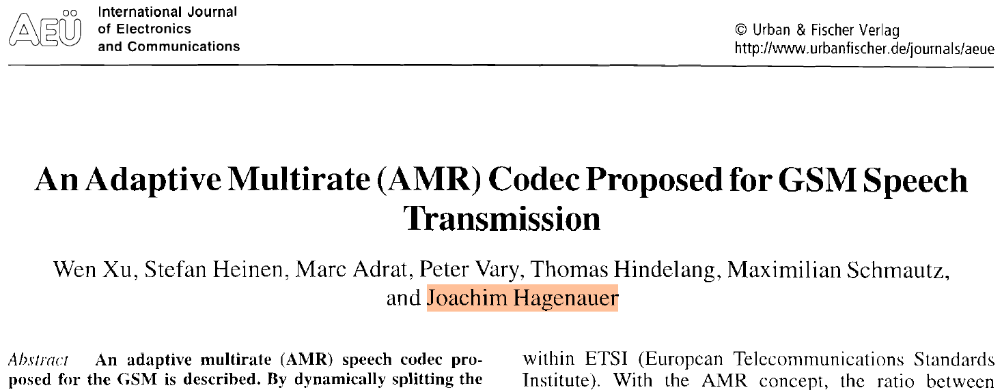
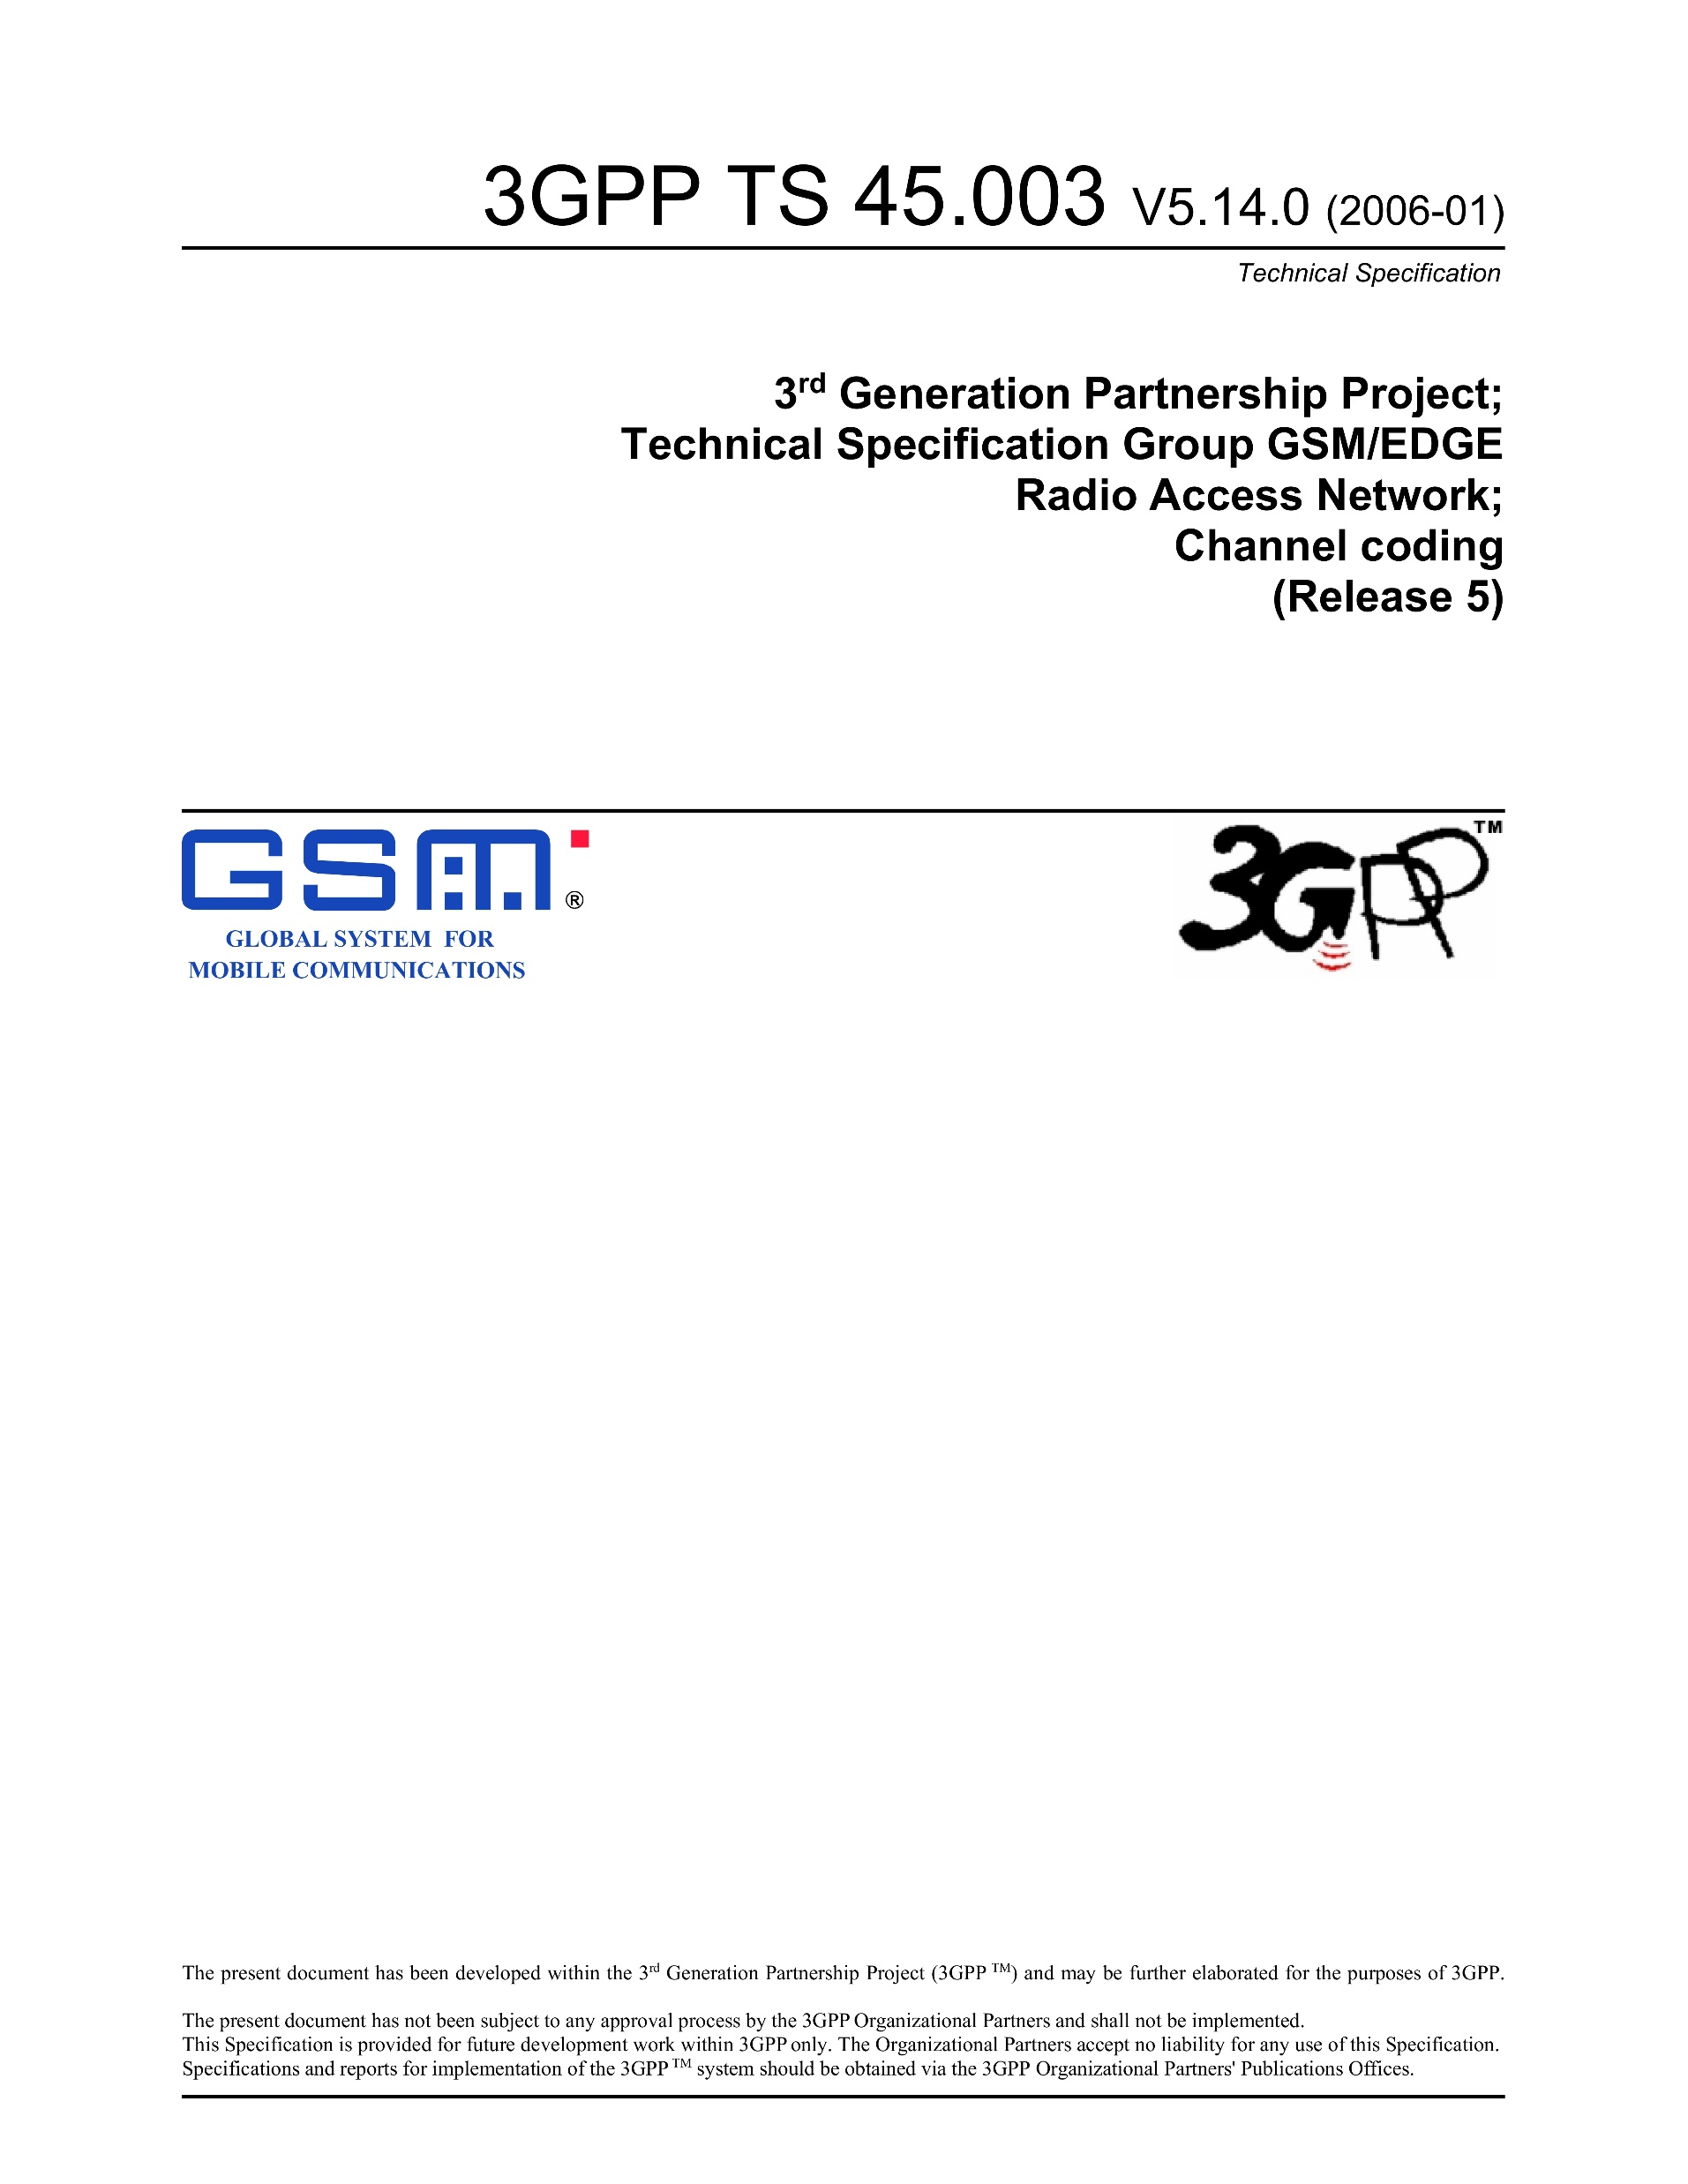
Close Cooperation with Industry
Prof. Hagenauer and his team at TUM not only conducted frontier academic research, but also had a cooperation tradition with industry.
An example successful story for industry cooperation
During 1998 – 2000, an adaptive multirate (AMR) codec was developed in a close cooperation among Siemens, RWTH Aachen (Prof. Vary) and TUM (Prof. Hagenauer), and submitted (as the Siemens proposal) to ETSI for standardization. “Although the codec proposal described here did not win the competition, some novel techniques like the use of RSC codes for AMR channel coding has been accepted by the ETSI standardization group and integrated in the current AMR standard” [1].
Compared with non-recursive convolutional codes, the recursive systematic convolutional (RSC) codes can significantly reduce the BER and improve the speech decoding [1]. As a result, the RSC codes have been specified in 3GPP/GSM Rel. 4/5 [2] as channel coding schemes for AMR and later also for AMR-WB (wideband) speech transmissions, and hence used worldwide – even today – in all handsets supporting GSM.
[1] W. Xu, …, J. Hagenauer, “An adaptive multirate (AMR) codec proposed for GSM speech transmission,” Int. J. Electron. and Comm. (AEÜ), 2000.
[2] 3GPP TS 45.003, Channel coding (Rel. 5), 2006.

